Slide 1
(Digital Modulation Basics – part 2)
Data Transmission And Digital Communication
By: Elham Sunbu

Slide 2
OUTLINE
Quadrature Amplitude Modulation

Slide 3



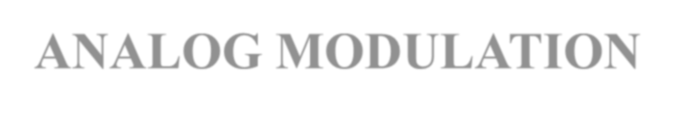
DIGITAL-TO-ANALOG MODULATION
Process of changing one of the characteristic of an analog signal (typically a sinewave) based on the information in a digital signal.
Sinewave is defined by 3 characteristics (amplitude, frequency, and phase) ⇒ digital data (binary 0 & 1) can be represented by varying any of the three.

Slide 4
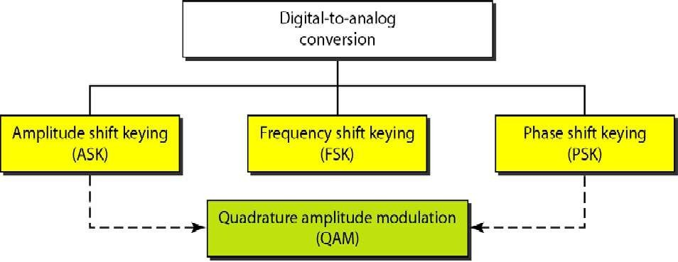
TYPES OF DIGITAL-TO-ANALOG MODULATION

Slide 5
ITRODUCTION ‐QAM
Quadrature Amplitude Modulation or QAM is a form of modulation which is widely used for modulating data signals onto a carrier used for radio communications.
It is widely used because it offers advantages over other forms of data modulation such as PSK, although many forms of data modulation operate along side each other.
Quadrature Amplitude Modulation, QAM is a signal in which two carriers shifted in phase by 90 degrees are modulated and the resultant output consists of both amplitude and phase variations. In view of the fact that both amplitude and phase variations are present it may also be considered as a mixture of amplitude and phase.

Slide 6
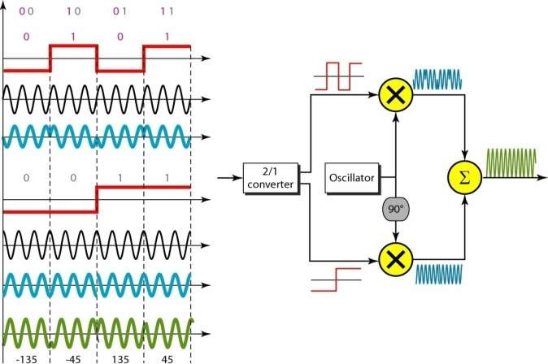
BLOCK DIAGRAM OF QAM MODULATION
Bk
Sin(Wct
)
Ak
Cos(Wct)

Slide 7
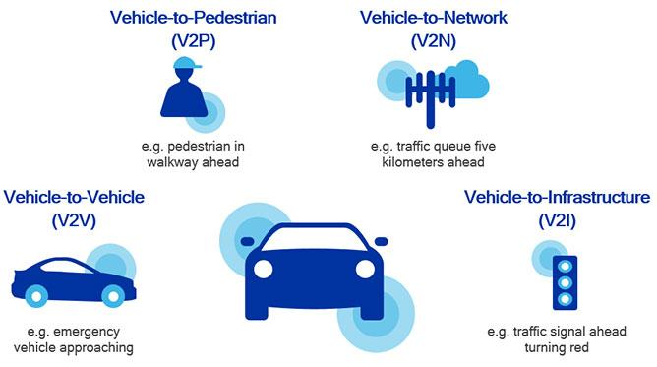
QAM APPLICATIONS
QAM is in many radio communications and data delivery applications. However some specific variants of QAM are used in some specific applications and standards.
For domestic broadcast applications for example, 64 QAM and 256 QAM are often used in digital cable television and cable modem applications. In the UK, 16 QAM and 64 QAM are currently used for digital terrestrial television using DVB Digital Video Broadcasting. In the US, 64 QAM and 256 QAM are the mandated modulation schemes for digital cable as standardised by the SCTE in the standard ANSI/SCTE 07 2000.
In addition to this, variants of QAM are also used for many wireless and cellular technology applications.

Slide 8
ADVANTAGES OF QAM
QAM appears to increase the efficiency of transmission for radio.
communications systems by utilizing both amplitude and phase variations.

Slide 9
DISADVANTAGES OF QAM
More susceptible to noise because the states are closer together so that a lower.
level of noise is needed to move the signal to a different decision point.
Receivers for use with phase or frequency modulation are both able to use limiting amplifiers that are able to remove any amplitude noise and thereby improve the noise reliance. This is not the case with QAM.
The second limitation is also associated with the amplitude component of the signal. When a phase or frequency modulated signal is amplified in a radio transmitter, there is no need to use linear amplifiers, whereas when using QAM that contains an amplitude component, linearity must be maintained. Unfortunately linear amplifiers are less efficient and consume more power, and this makes them less attractive for mobile applications.

Slide 10
CONSTELLATION DIAGRAMS FOR QAM
Quadrature amplitude modulation, QAM, when used for digital transmission for radio communications applications is able to carry higher data rates than ordinary amplitude modulated schemes and phase modulated schemes. As with phase shift keying, etc, the number of points at which the signal can rest, i.e. the number of points on the constellation is indicated in the modulation format description, e.g. 16QAM uses a 16 point constellation.
When using QAM, the constellation points are normally arranged in a square grid with equal vertical and horizontal spacing and as a result the most common forms of QAM use a constellation with the number of points equal to a power of 2 i.e. 2, 4, 8, 16 . . . .

Slide 11
By using higher order modulation formats, i.e. more points on the constellation, it is possible to transmit more bits per symbol. However the points are closer together and they are therefore more susceptible to noise and data errors.
To provide an example of how QAM operates, the table below provides the bit sequences, and the associated amplitude and phase states. From this it can be seen that a continuous bit stream may be grouped into threes and represented as a sequence of eight permissible states.

Slide 12
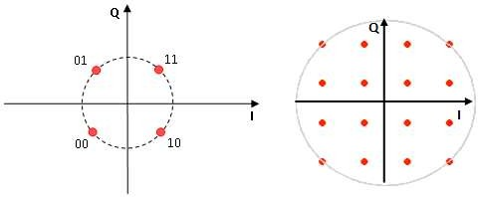
The constellation diagrams show the different positions for the states within different forms of QAM, quadrature amplitude modulation. As the order of the modulation increases, so does the number of points on the QAM constellation diagram.
The diagrams below show constellation diagrams for a variety of formats of modulation:

Slide 13
WHY QAM CALLED COMBINED ASK AND PSK
Quadrature Amplitude Modulation uses the phase and amplitude of the carrier signal to encode data. QAM finds widespread use in current and emerging wireless standards, including Wi-Fi, Digital Video Broadcast (DVB), WiMAX, IEEE 802.11n, and HSDPA/HSUPA.
The QAM modulation scheme encodes data by varying both amplitude and phase of the carrier signal. Thus, it is sometimes viewed as a combination of ASK and PSK modulation.
A modulated carrier signal can be expressed in terms of it’s components as:
Ac Cos(2*pi*fc*t+θ) =ICos(2*pi*fc*t) - QSin(2*pi*fc*t)
Where I = Ac Cosθ and Ac Sinθ Q=Ac Sinθ

Slide 14
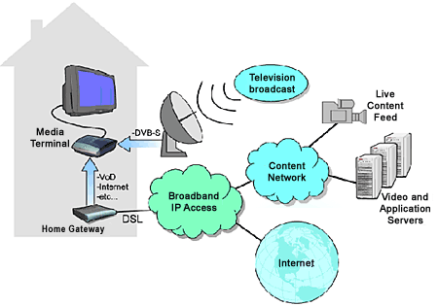
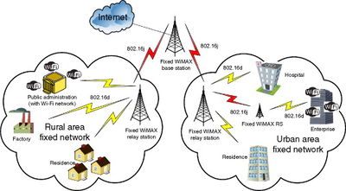
Conclusion
Quadrature Amplitude Modulation is an important modulation scheme with many practical applications, including current and future wireless technologies. Some examples of communication systems that use QAM are Wi‐Fi, cable modems, Digital Video Broadcast (DVB) and WiMAX.

Slide 15
Thank You

